Slide 1
Information Security
Ms. Nabeela Bibi

Slide 2
What is cipher?
In cryptology, the discipline concerned with the study of cryptographic algorithms, a cipher is an algorithm for encrypting and decrypting data.
Symmetric key encryption, also called secret key encryption, depends on the use of ciphers, which operate symmetrically.

Slide 3
Types/ Categories of Ciphers
Traditionally, ciphers used these two main types of transformation:
Transposition ciphers keep all the original bits of data in a byte but mix their order.
Substitution ciphers replace specific data sequences with other data sequences. For example, one type of substitution would be to transform all bits with a value of 1 to a value of 0, and vice versa.

Slide 4
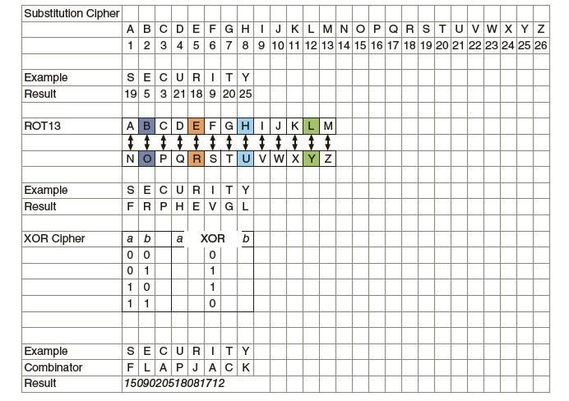
Notes:
Steganography typically takes the data, divides it into smaller pieces, and hides these in unused portions of the file.
Steganography may hide data the file header fields that describe the file, between sections of
the metadata (data that is used to describe the content or structure of the actual data), or in the areas of a file that contain the content itself.
Steganography can use a wide variety of file types image files, audio files, video files, etc.to hide messages and data.

Slide 5
There are different categories of algorithms and within those different types.
One category is a substitution cipher that substitutes one character for another. By substituting 1 for the letter A, 2 for the letter B, etc., the word security becomes 1804022017081924 (-1 for 1953211892025).
One type of substitution cipher is a ROT13, in which the entire alphabet is rotated 13 steps: A=N, B=O, etc., so that the word security becomes frphevgl.
Another common algorithm is the XOR cipher. This is based on the binary operation eXclusive OR that compares two bits: if the bits are different a 1 is returned, but if they are identical then a 0 is returned. For example, to encrypt the word security by “XOR-ing” it with the word flapjack the binary equivalent of the first letter s(01110011) is compared with that of the letter f (01100110) to return 00010101. Then the letter e is compared with the l, etc., followed by a comparison of each remaining letter.

Slide 6
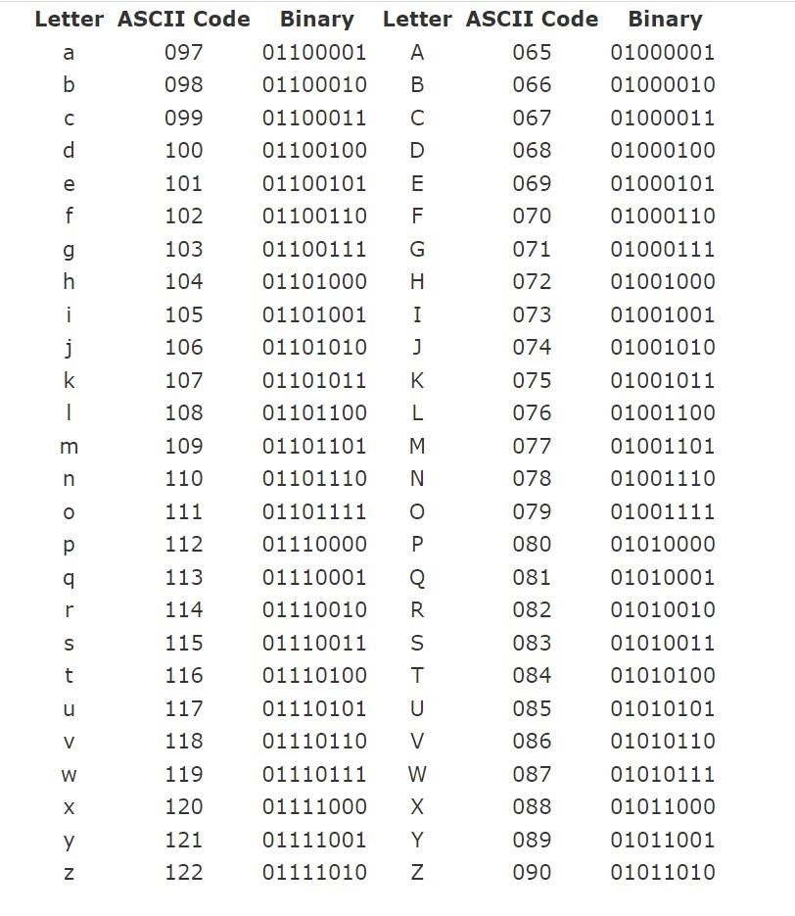
Alphabet to Binary

Slide 7
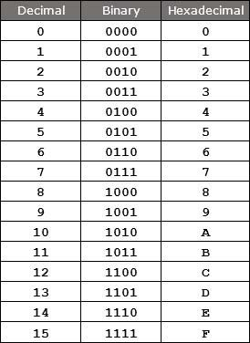
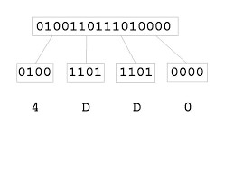
Binary to Hexadecimal

Slide 8
ROT - 13
The ROT-13 cipher was commonly used to hide the meaning of messages on the Internet (particularly on Usenet and E-mail).
Each letter in the plaintext is substituted with the ciphertext letter according to the following mapping:
p : ABCDEFGHIJKLMNOPQRSTUVWXYZ • F(p) : NOPQRSTUVWXYZABCDEFGHIJKLM
Example:
Plaintext: THIS IS A SECRET
Ciphertext: GUVF VF N FRPERG

Slide 9
Caesar Cipher
The Roman emperor Julius Caesar used to substitute each letter in his diplomatic communications with the letter that was three letters further along in the alphabet.
p : ABCDEFGHIJKLMNOPQRSTUVWXYZ
F(p) : DEFGHIJKLMNOPQRSTUVWXYZABC
Plaintext: ET TU BRUTUS
Ciphertext: HW WX EUXWXV

Slide 10


Affine Cipher
The Affine cipher is a type of mono-alphabetic substitution cipher, wherein each letter in an alphabet is mapped to its numeric equivalent, encrypted using a simple mathematical function, and converted back to a letter
Encryption Function
Decryption Function
Here a and m must be coprime numbers

Slide 11
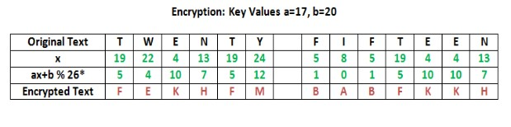
Affine Cipher Example

Slide 12
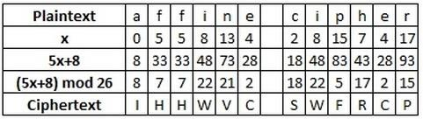
Affine Cipher Example

Slide 13
How to calculate mod 26
First divide the number by 26
Minus the value before decimal point
Then multiply by 26
The answer will be remainder.
For example
210 mod 26
210/ 26 = 8.07
-8
Then multiple by 26
The remainder is 2

Slide 14

Transpositional Cipher: Railfence
The plaintext is written down as a sequence of diagonals and then read off as a sequence of rows.
For example, to encipher the message “meet me after the toga party” with a rail fence of depth 2, we write the following:
The encrypted message is
MEMATRHTGPRYETEFETEOAAT

Slide 15
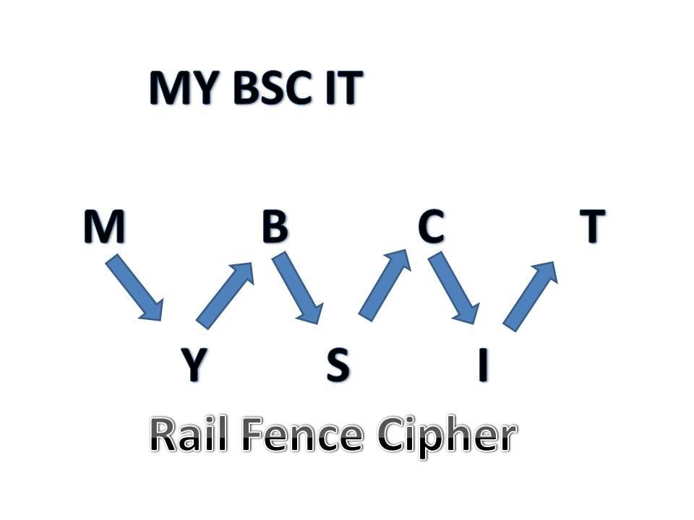
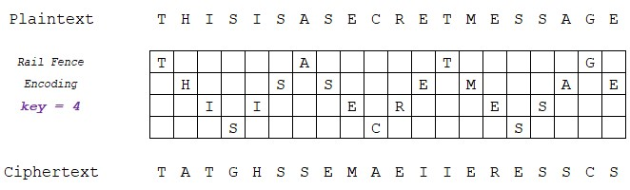

Slide 16
Columnar Transpositional Cipher
Problems with the rail fence cipher:
The first and last letters of the plaintext do not move
The key is a number that divides the total message length
In a single columnar transposition cipher, the key is a word or phrase whose letters, in alphabetic order, indicate the order of the columns as they are read

Slide 17
Columnar Transpositional Cipher
Example:
Plaintext: TRANSPOSITIONCIPHER
Key is “SECRET”, so re-write as rows of 6-letter blocks:
–Ciphertext: AIIXRSCXSIHXNTPXTONRPOEX
SECRET | CEERST
521436 | 123456
TRANSP | ARSNTP
OSITIO | ISITOO
NCIPHE | ICHPNE
RXXXXX | XXXXRX

Slide 18
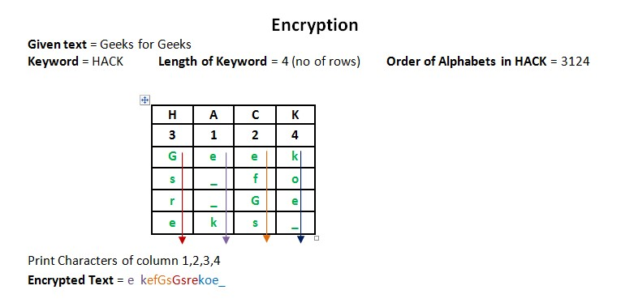
No of columns

Slide 19
Cryptanalysis
Cryptanalysis is the study of breaking ciphers (also called code breaking or cracking) or reading encrypted messages without knowledge of the key
Goals:
Decrypt a message
Recover the key
Types of attacks depend on:
The type of information available
Interaction with the cipher

Slide 20
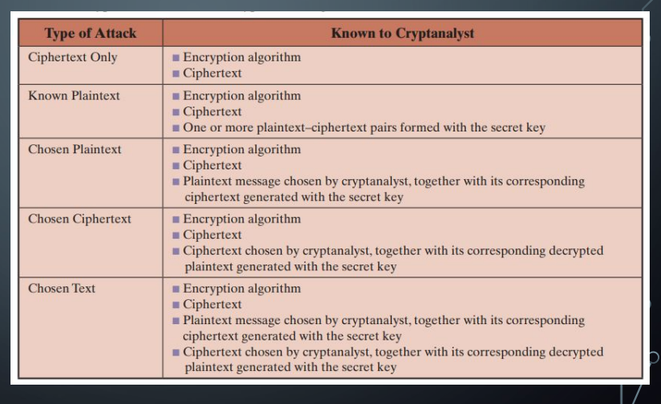
Types of Attacks on Encrypted Messages
The table summarizes the various types of cryptanalytic attacks based on the amount of information known to the cryptanalyst.

Slide 21
Computational vs. Unconditional Secure
An encryption scheme is unconditionally secure if the ciphertext generated by the scheme does not contain enough information to determine uniquely the corresponding plaintext, no matter how much ciphertext is available.
That is, no matter how much time an opponent has, it is impossible for him or her to decrypt the ciphertext simply because the required information is not there
An encryption scheme is said to be computationally secure if either of the foregoing two criteria are met.
Unfortunately, it is very difficult to estimate the amount of effort required to cryptanalyze ciphertext successfully.

Slide 22
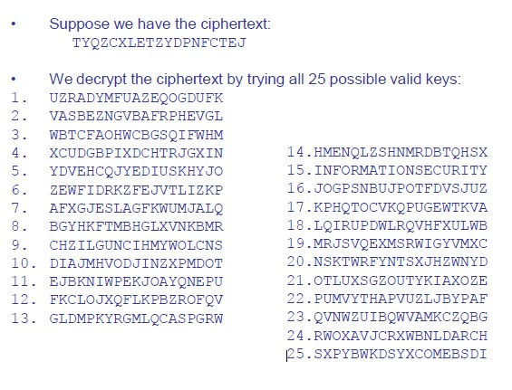
Example: Exhaustive key search

Slide 23
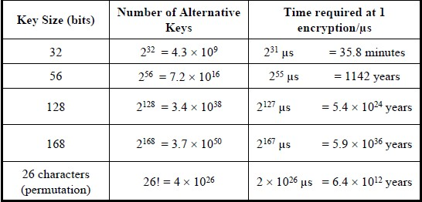
Brute Force Search
Always possible to simply try every key
Most basic attack, proportional to key size

Slide 24
Cracking the simple substitution cipher
There are 26! = ~4 x 10^26 possible keys
Exhaustive key search is not practical
Simple substitution ciphers were considered strong for many centuries
In 850 CE, Arab/Iraqi scientist Abu Yusuf Yaqub ibn Ishaq al-Kindi published his book “Risalah fi Istikhraj al-Mu‟amma” (A Manuscript on Deciphering Cryptographic Messages), which contains the first ever published description of how to crack simple substitution ciphers
The method he described is now known as frequency analysis

Slide 25
Frequency analysis
The statistical distribution of letter frequencies of a message (text) written in any language tend towards a known letter frequency distribution profile of the language
This is particularly true for long messages (i.e., the longer the text, the closer the letter frequency distributions match the language's letter frequency distributions)
The simple substitution cipher preserves the letter frequency distributions of the plaintext in the ciphertext (i.e., information about the plaintext is leaked in the ciphertext)
The attacker takes a frequency count of the ciphertext letters and tries to match them to the letter frequency distribution profile of the plaintext language

Slide 26
One Time Pad
There are many variations of cryptographic algorithms. One variation is based on the device—if any—that is used in the cryptographic process.
Prior to this, cryptographic algorithms were entirely hand-calculated.
An example is a one-time pad (OTP) that combines plaintext with a random key.
A pad is a long sequence of random letters.
These letters are combined with the plaintext message to produce the ciphertext. To decipher the message, the recipient must have a copy of the pad to reverse the process.

Slide 27
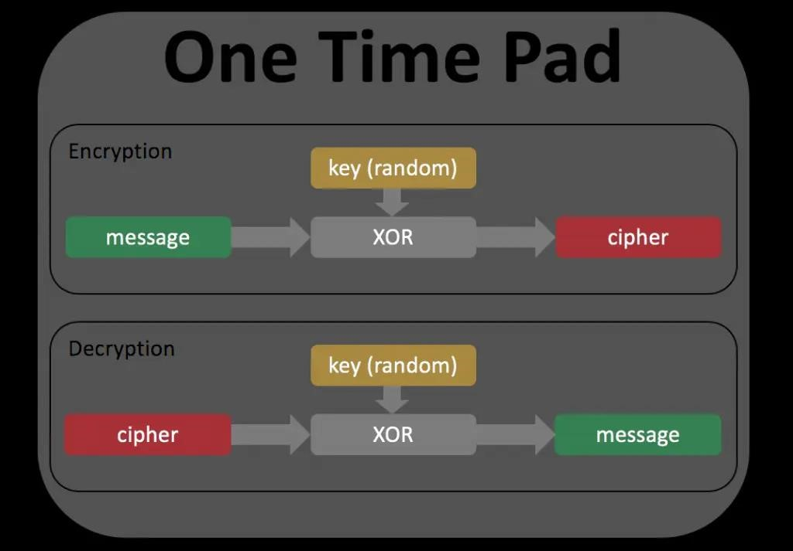
One Time Pad

Slide 28
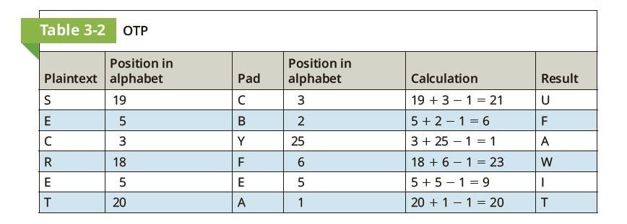
One Time Pad

Slide 29
One Time Pad
To encipher a message, the position in the alphabet of the first letter in the plaintext message is added to the position in the alphabet of the first random letter from the pad.
For example, if SECRET is to be encrypted using the pad CBYFEA, the first letter S (#19 of the alphabet) is added to the first letter of the pad C (#3 of the alphabet) and then 1 is subtracted (19 1 3 2 1 5 21). This results in U (#21 of the alphabet).
Each letter is similarly encrypted (any number larger than 26 is wrapped around to the start of the alphabet). To decipher a message, the recipient takes the first letter of the ciphertext and subtracts the first random letter from the pad (any negative numbers are wrapped around to the end of the alphabet).

Slide 30
Activity
Plain Text : ATTACK AT DAWN
Pad: YUPRQI TW JKBN

Slide 31
Thank you!

